Slide 1
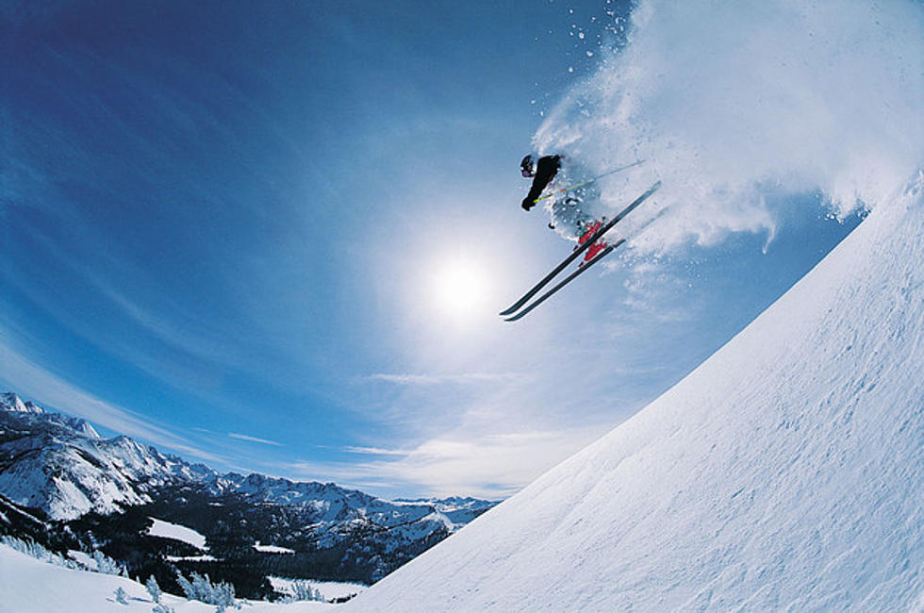

Big Mountain Resort
Data Report 2020

Slide 2
Problem Identification
What does Big Mountain Resort need to do to recoup the expense of the new chair lift and also to maintain its historical profit margin of 9.2%?

Slide 3
Recommendations
Modeling suggests a fair price of $86
Increase ticket price from $81 to $86
This generates an additional $1.75 mil/year
Covers the $1.54 mil/year of additional operating expenses from the new chair lift
New profit margin of 9.3%

Slide 4
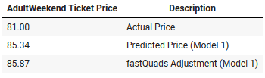
Model 1 Price Predictions
The model price prediction suggests a fair price of $86 for a Big Mountain Resort ticket.

Slide 5
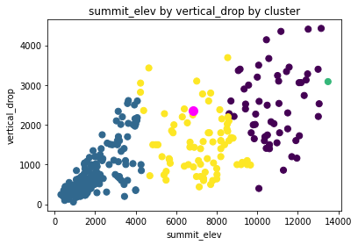
Elevation Ranking
Big Mountain Resort (magenta data point) is in the middle of the pack when it comes to elevation ranking.

Slide 6
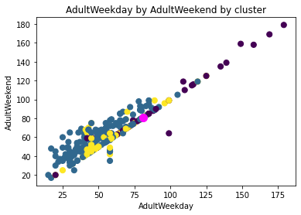
Price Ranking
Big Mountain Resort (magenta data point) is in the 84th percentile in price ranking and will move up to the 87th percentile after the price is increased to $86. The resorts range in price from $17 to $179. The average price is approximately $64.

Slide 7
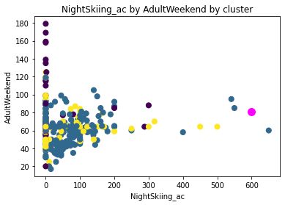
Night Skiing Ranking
Big Mountain Resort (magenta data point) is classified as an outlier in this category and it could very well explain why the ticket prices at the resort command an above-average price.

Slide 8
Current Numbers
350,000 annual visitors
$28.35 mil in annual revenues ($81/ticket)
$25.74 mil in annual expenses
9.2% profit margin

Slide 9
New Numbers
350,000 annual visitors
$1.75 mil in additional revenues (+$5/ticket)
$1.54 mil in additional expenses
9.3% profit margin

Slide 10
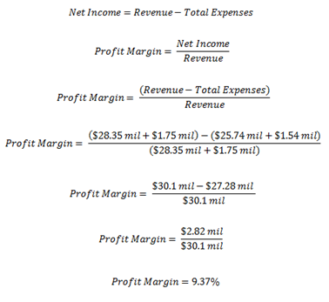
Calculations

Slide 11
Summary
The pricing model in this report suggests a fair price of $86 for a Big Mountain Resort ticket.
At this price point, the resort will generate $1.75 mil in additional yearly revenue and have a 9.3% profit margin.

